Slide 1



NLP with Disaster tweets

Slide 2
CONTENT
01
05
02
03
04
Import Libraries & Load Data
Train a Model
Data Preprocessing
06
Model Evaluation
Exploratory Data Analysis &
Train-Test Split
07
Plotting
Feature Extraction

Slide 3


01
Import Libraries & Load Data

Slide 4
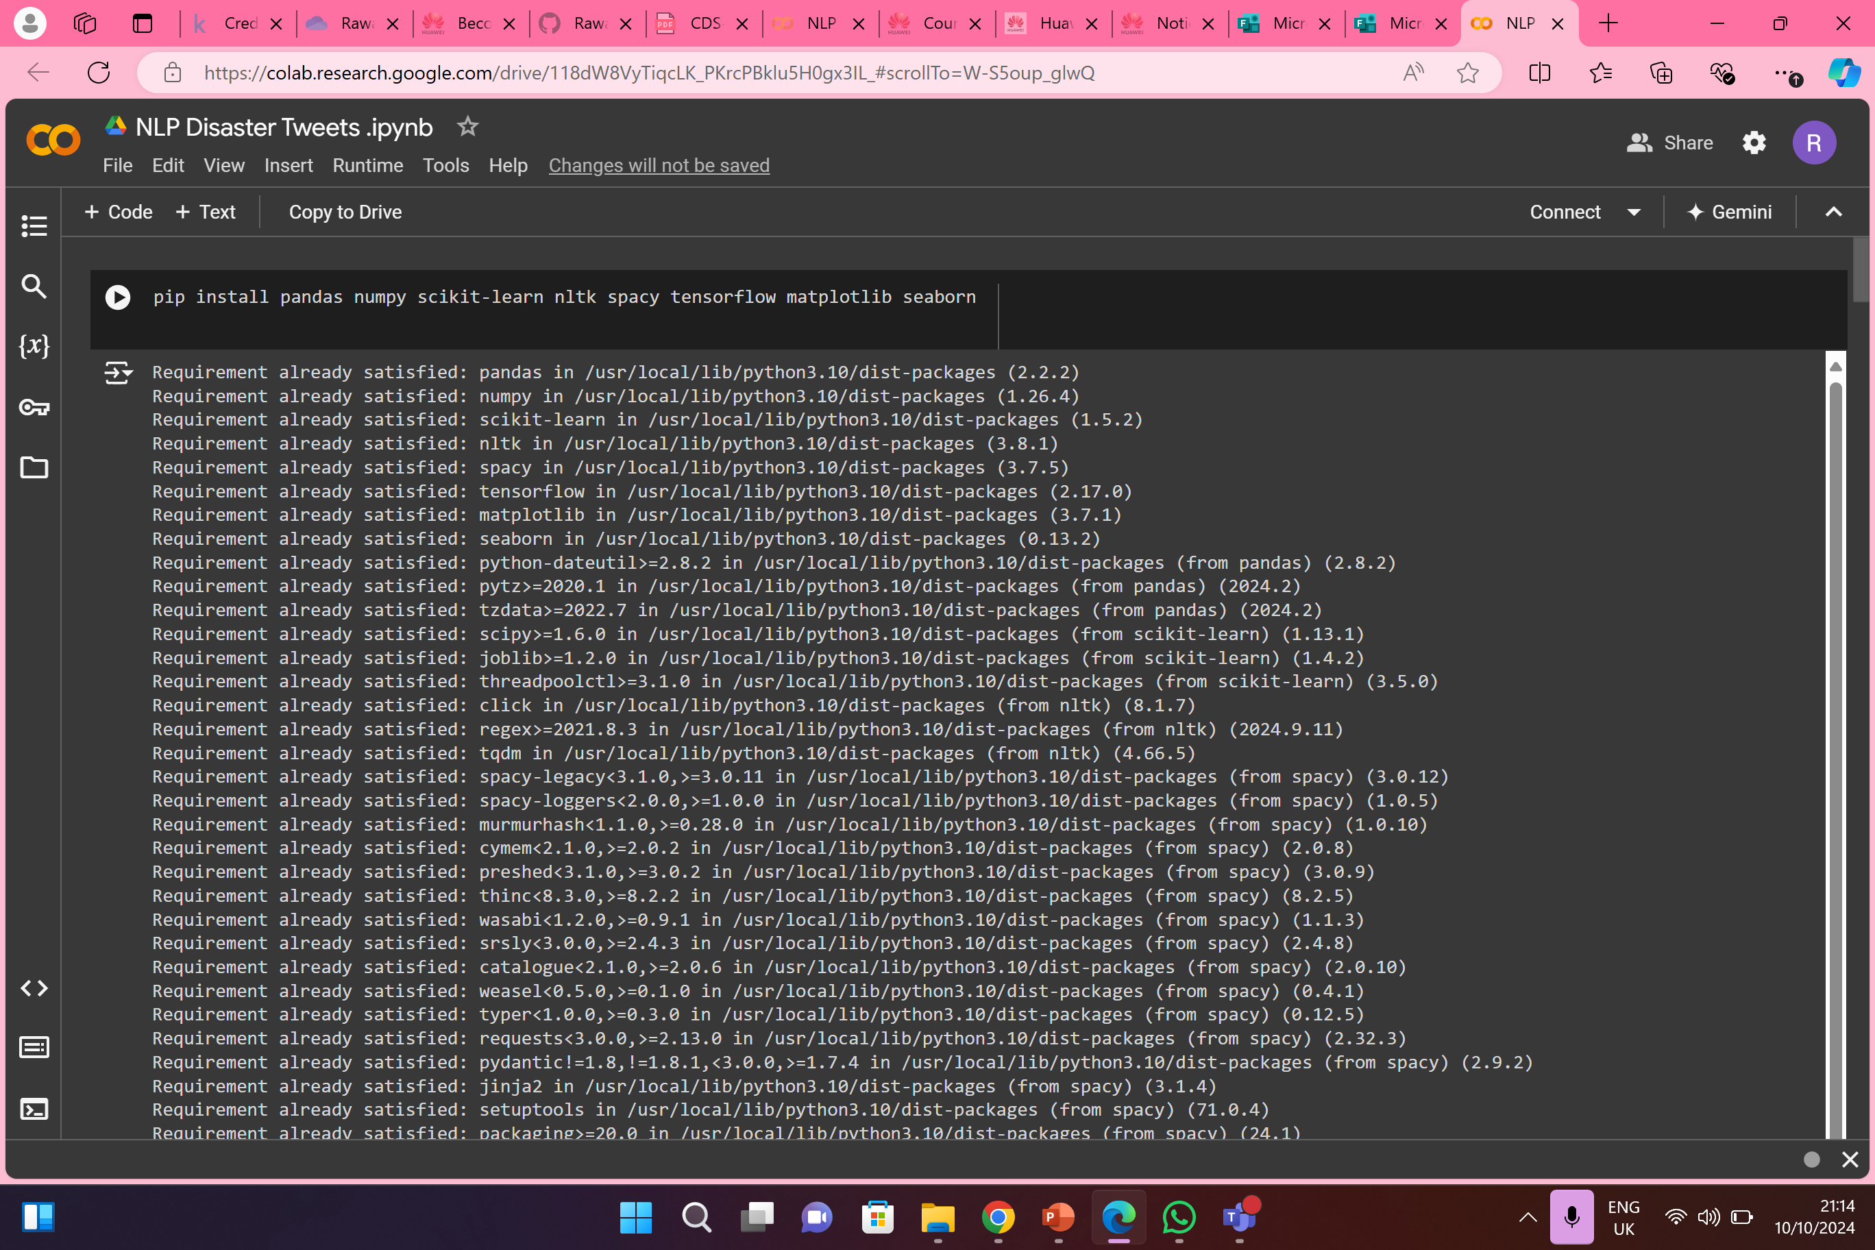
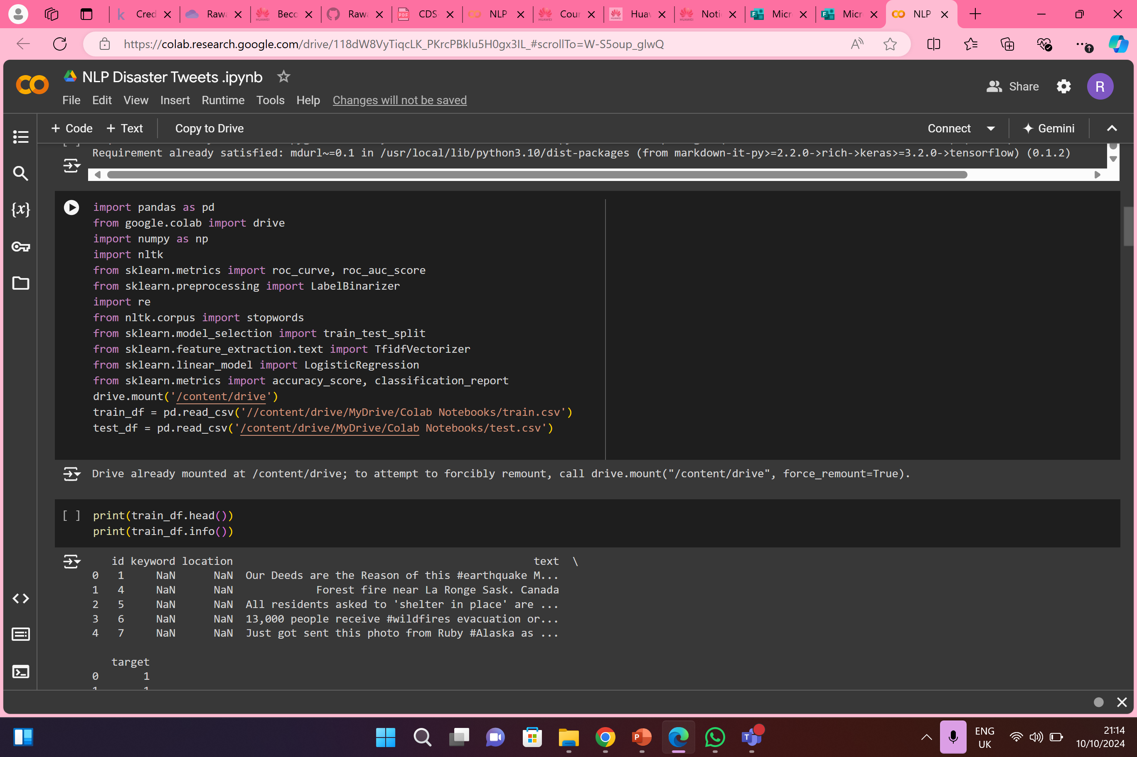
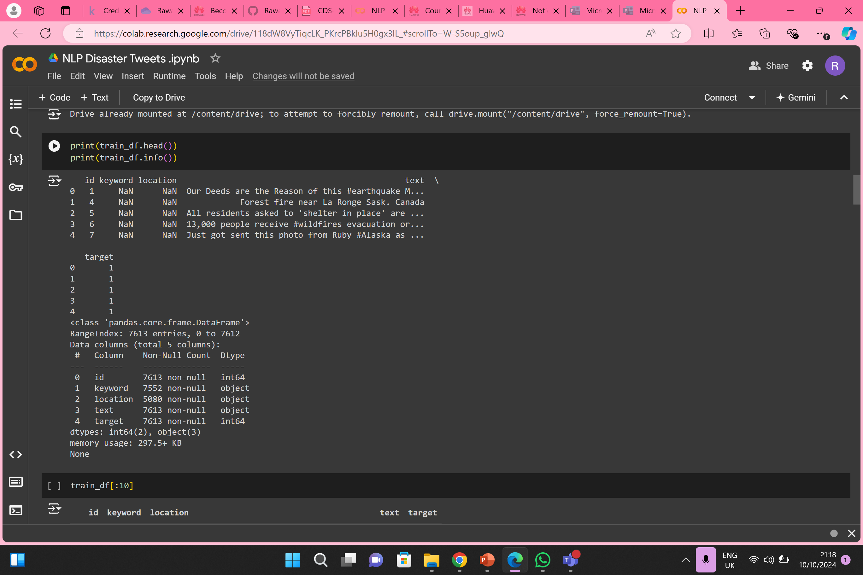
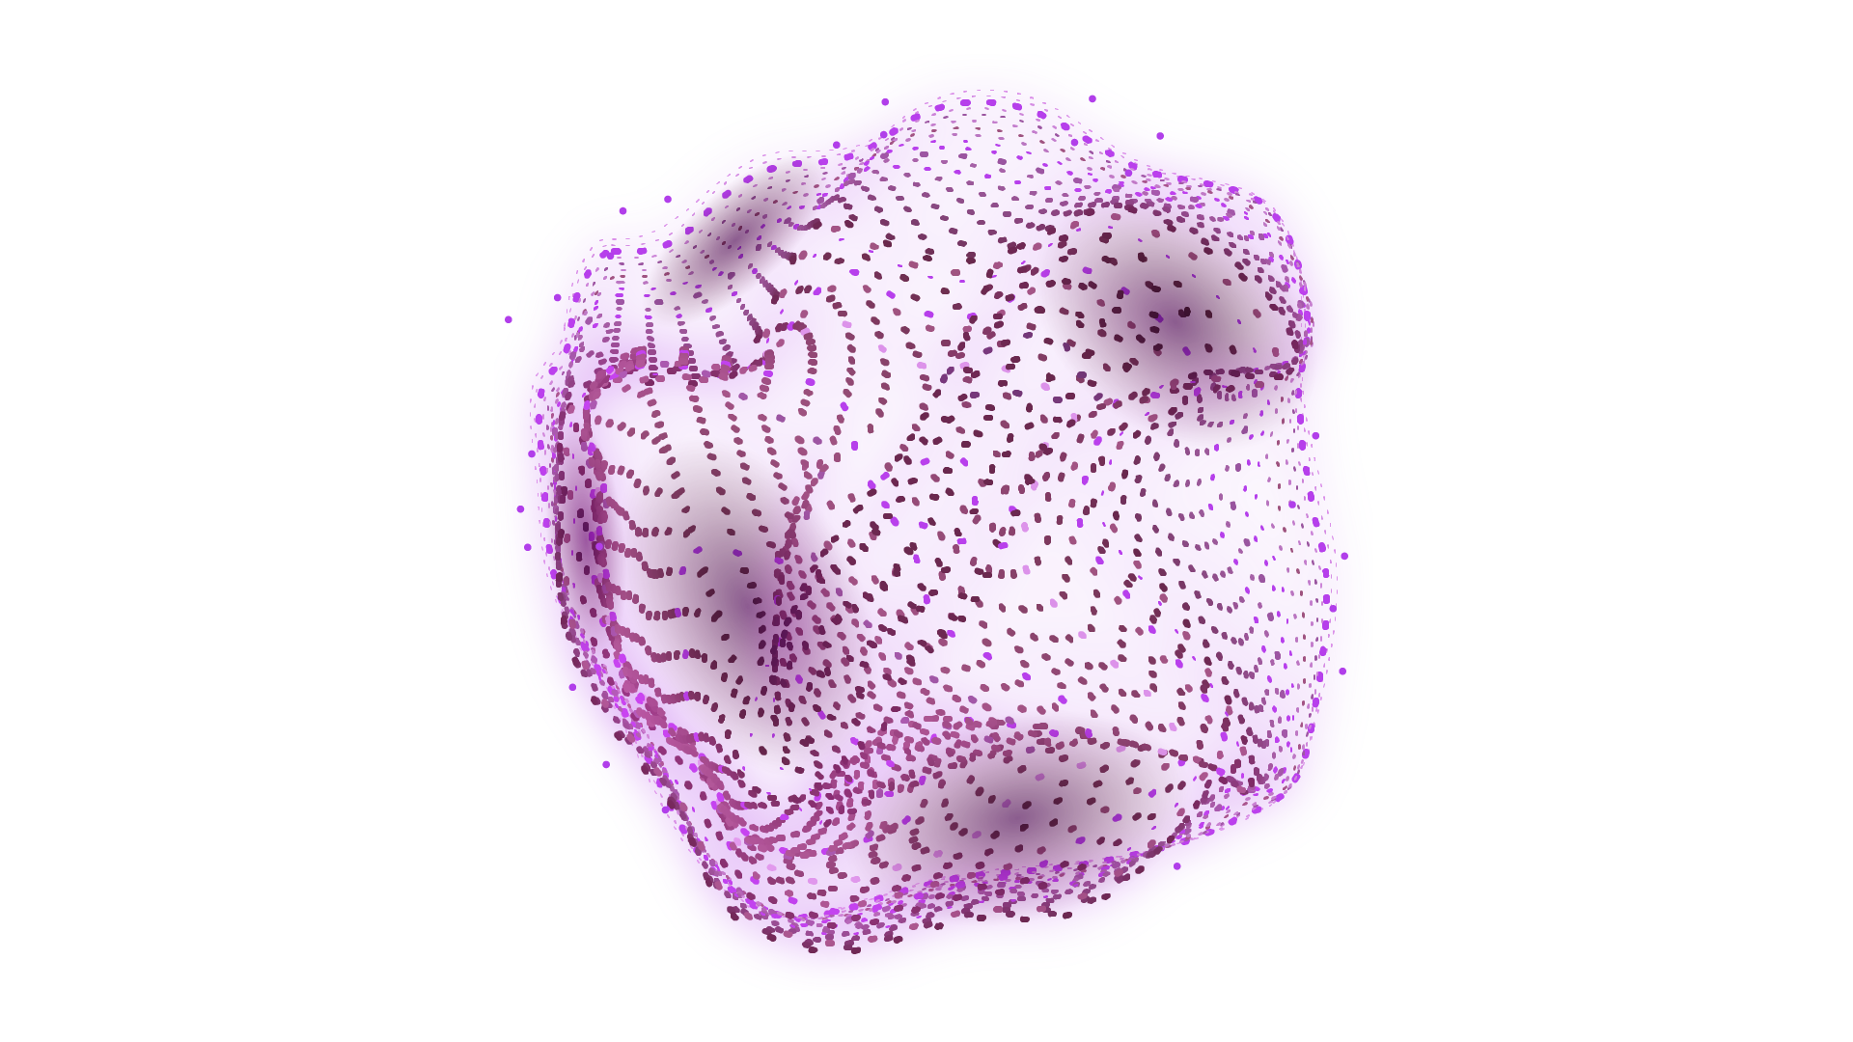
1.
2.
3.

Slide 5
02
Data Preprocessing

Slide 6
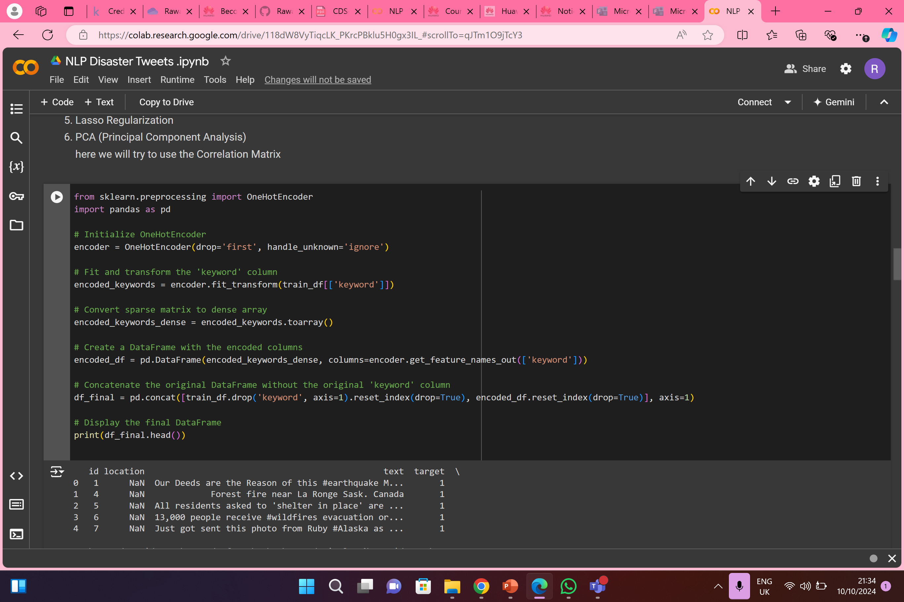
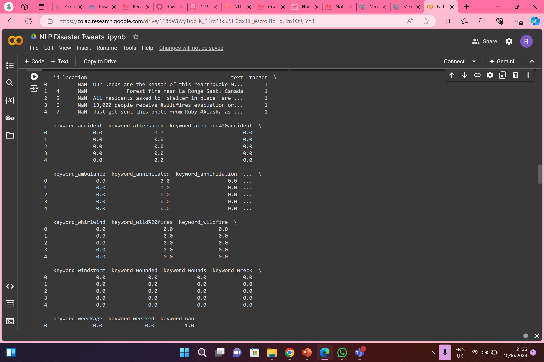
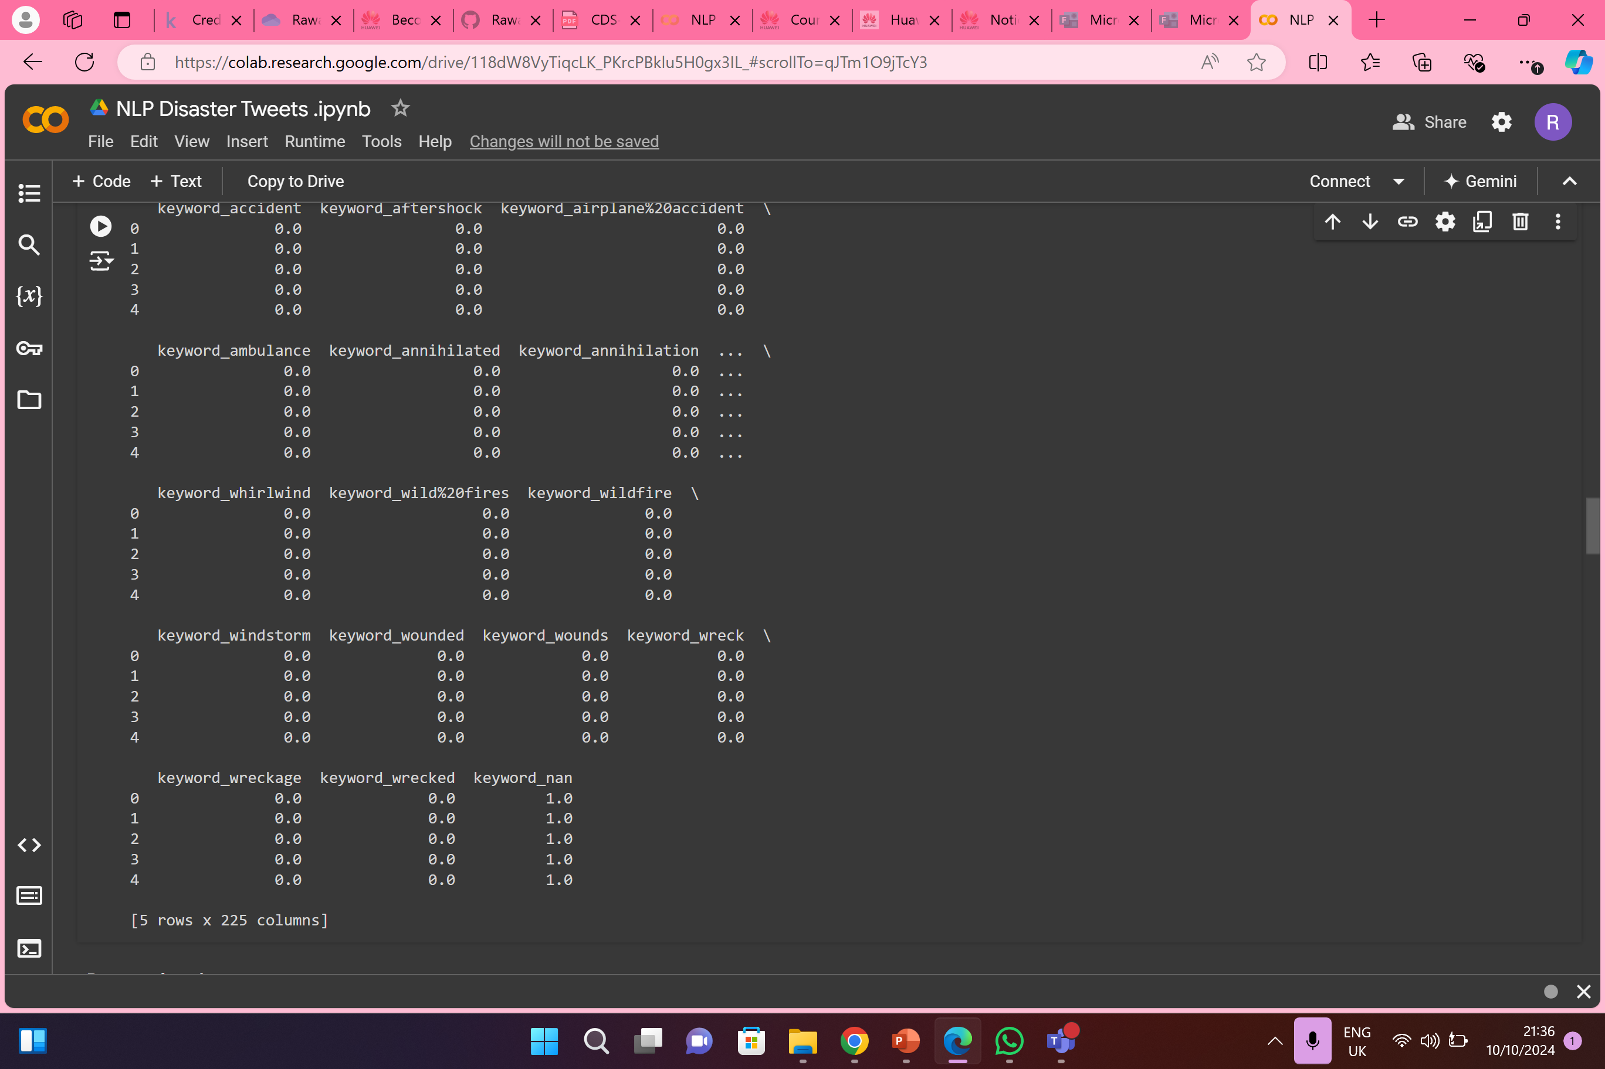
1.
2.
3.

Slide 7
03
Exploratory Data Analysis & Train-Test Split

Slide 8
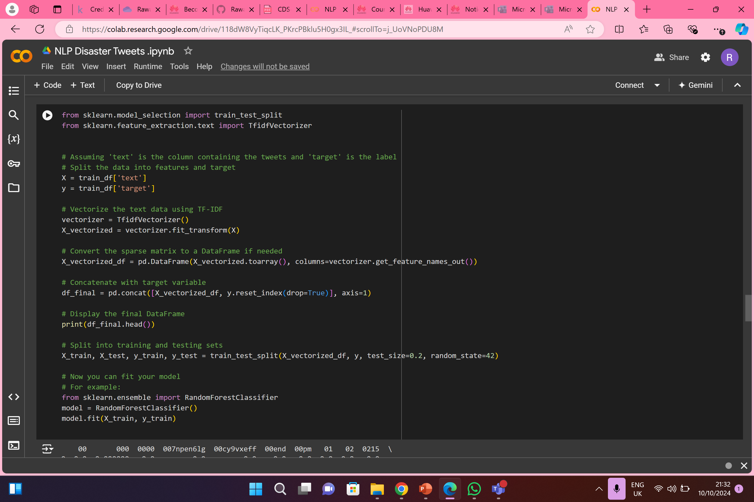
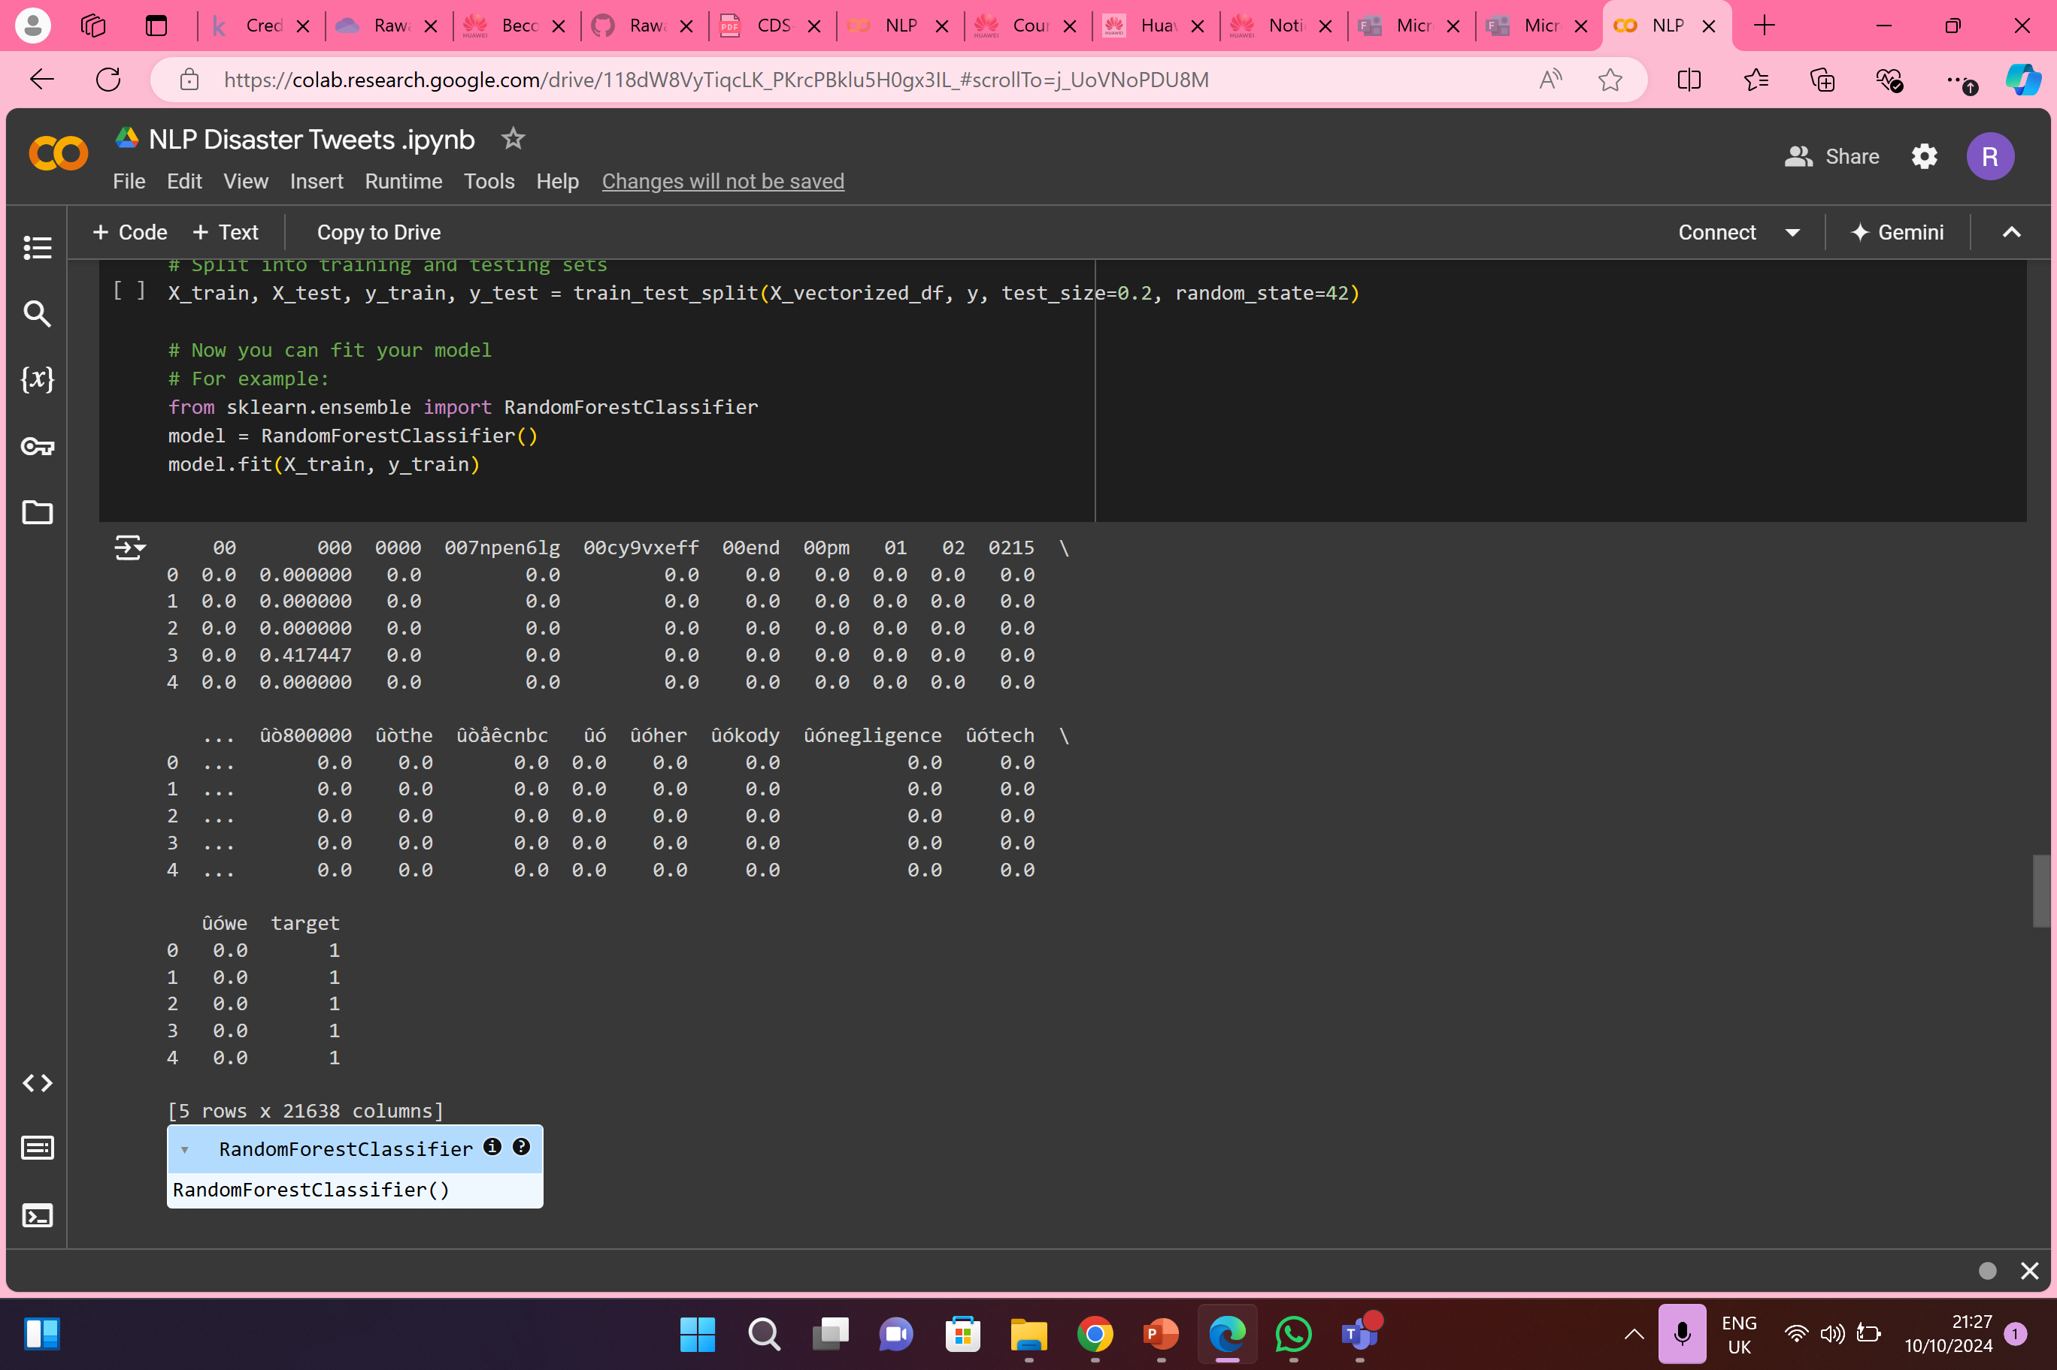
EDA
TRAIN
TEST

Slide 9
04
Feature Extraction

Slide 10
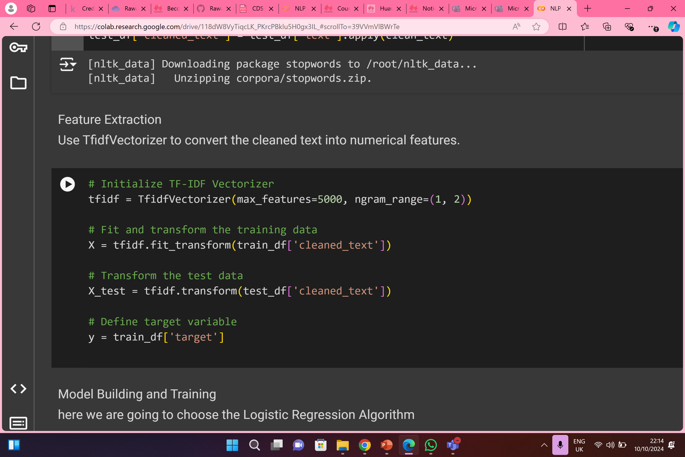
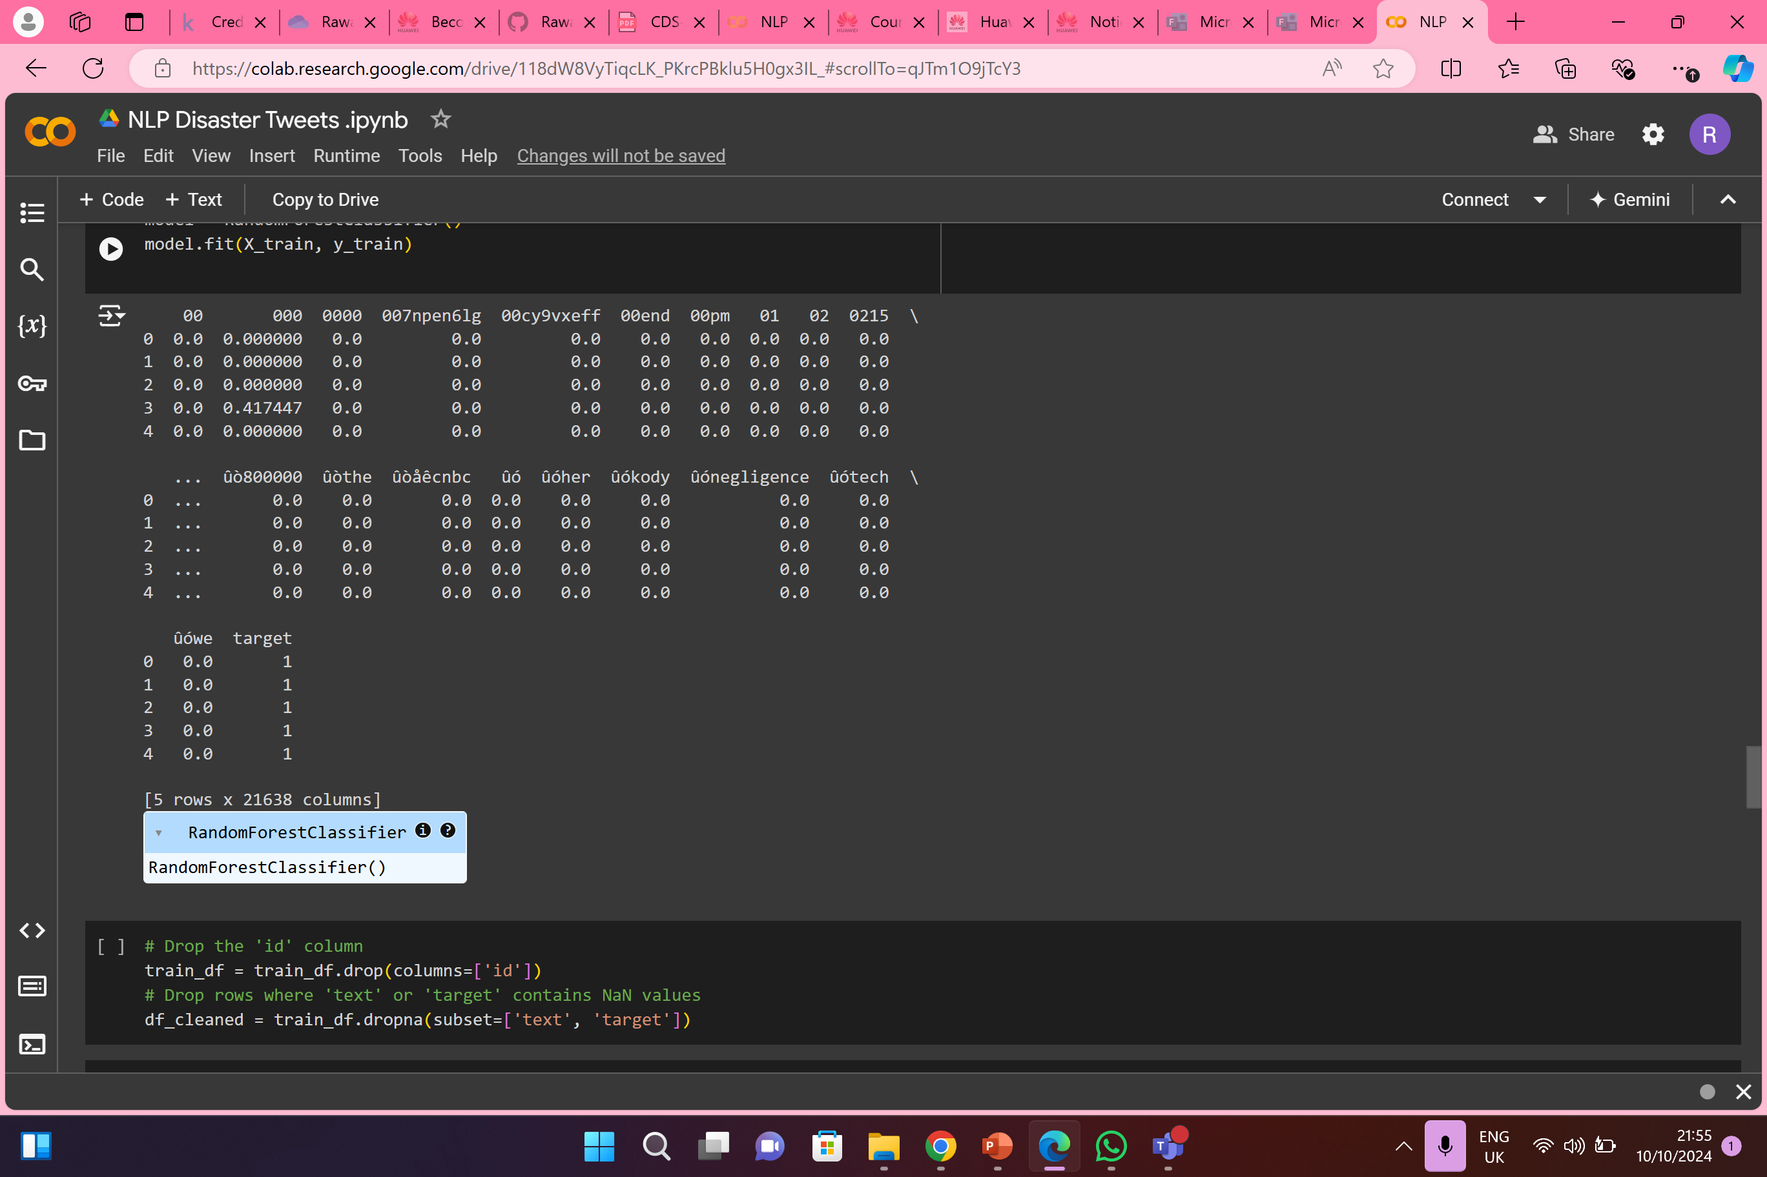
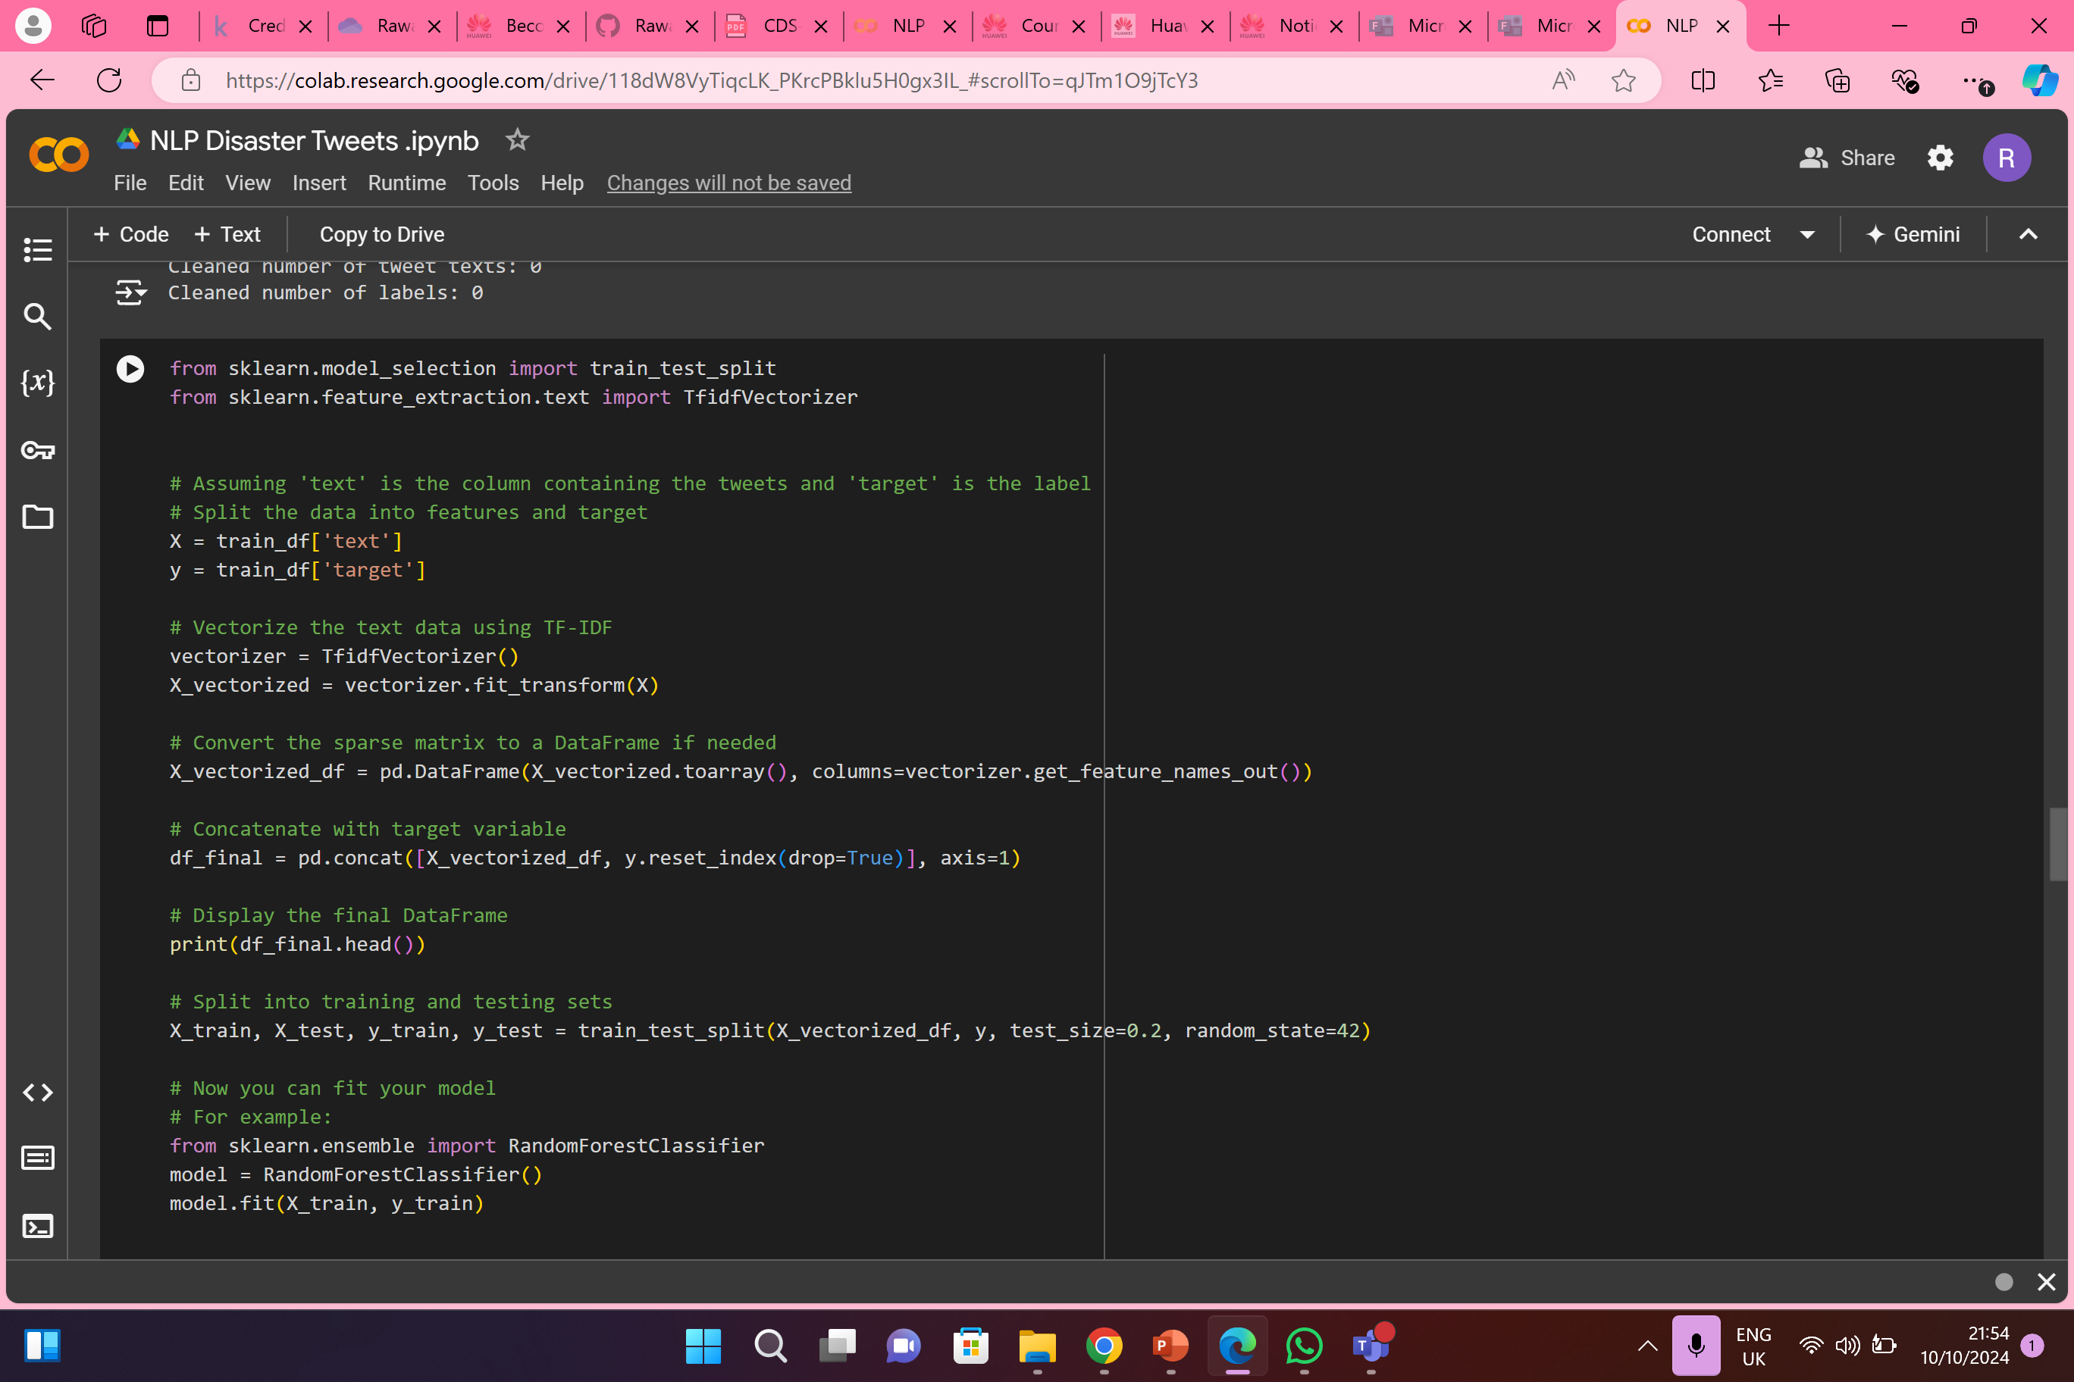
1.
2.
3.

Slide 11
05
Train a Model

Slide 12
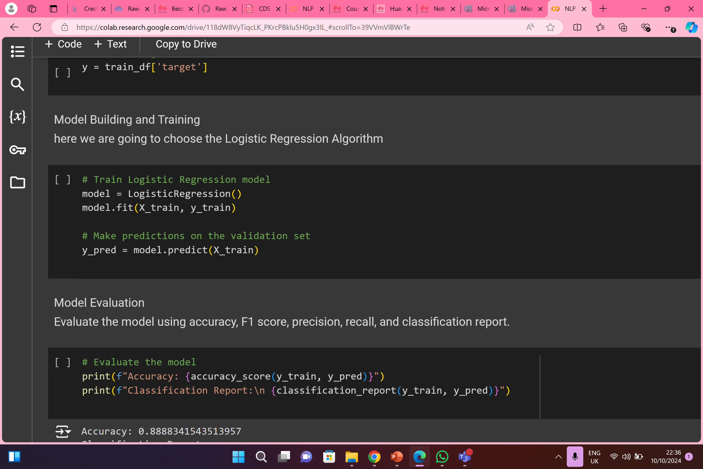
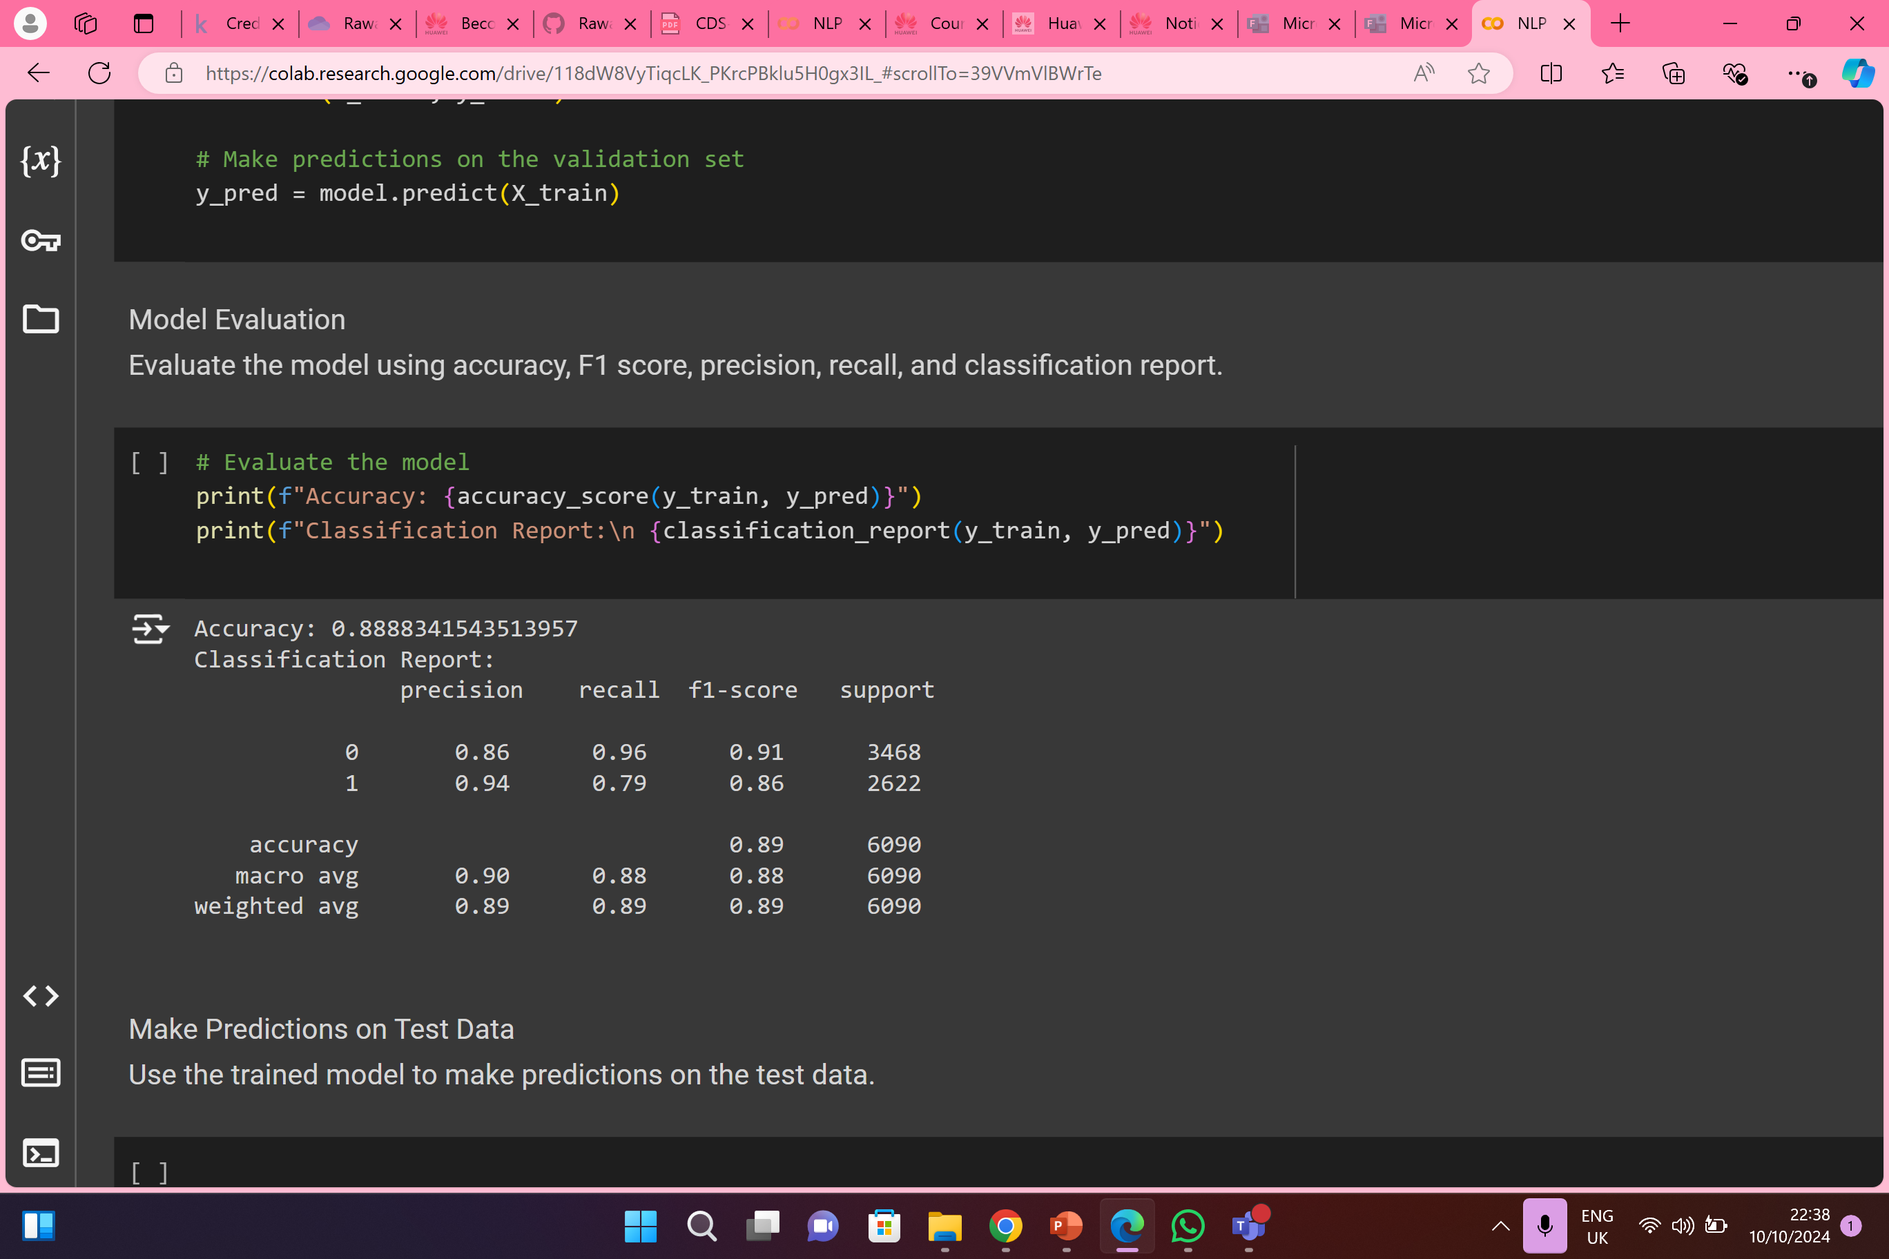

Slide 13
06
Model Evaluation

Slide 14
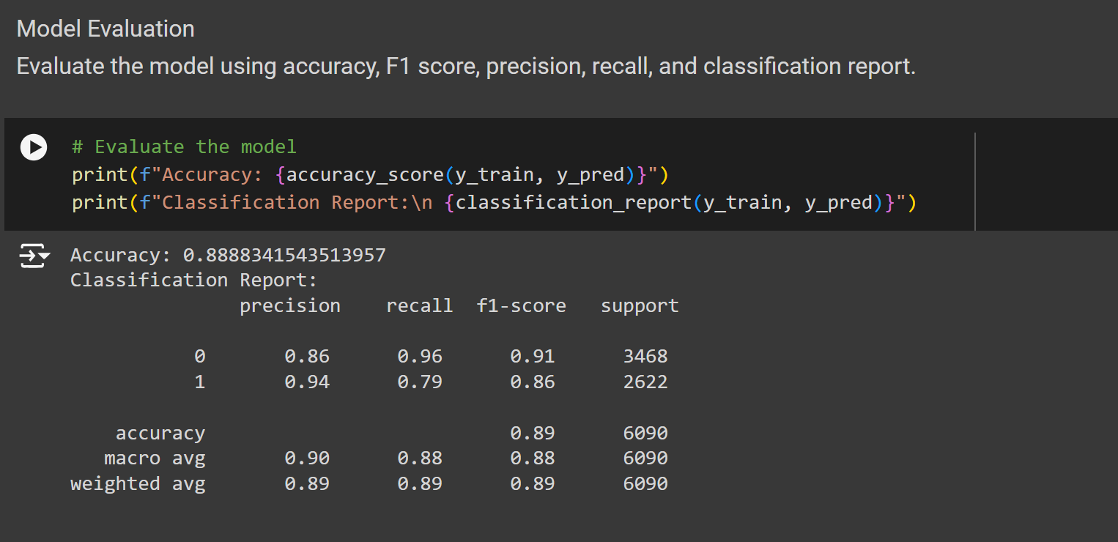

Slide 15
07
Plotting

Slide 16
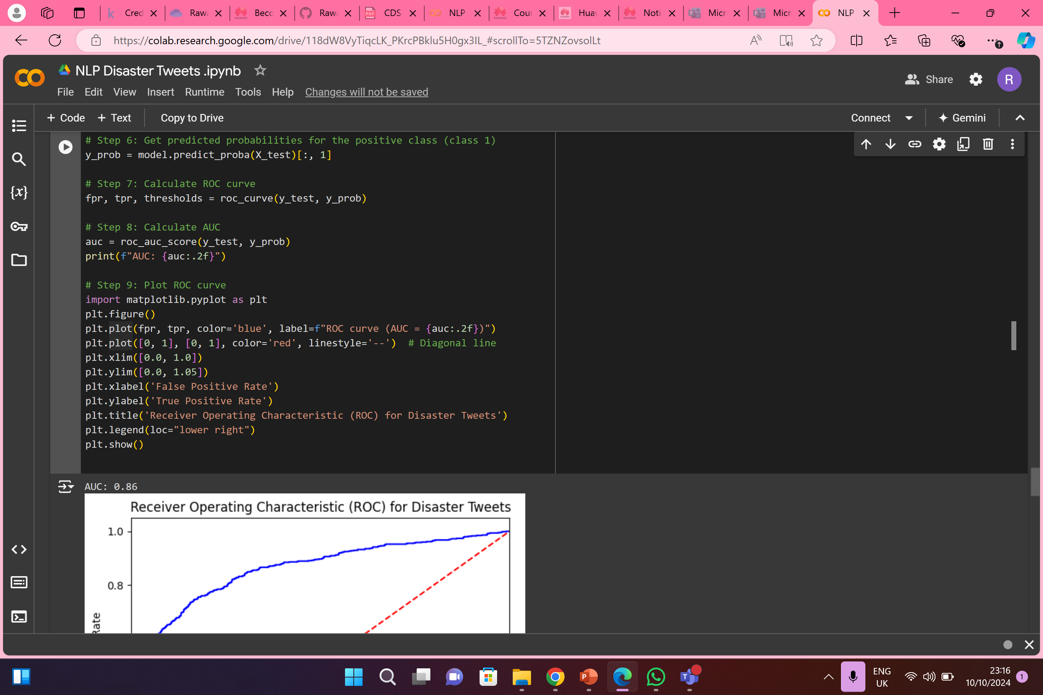
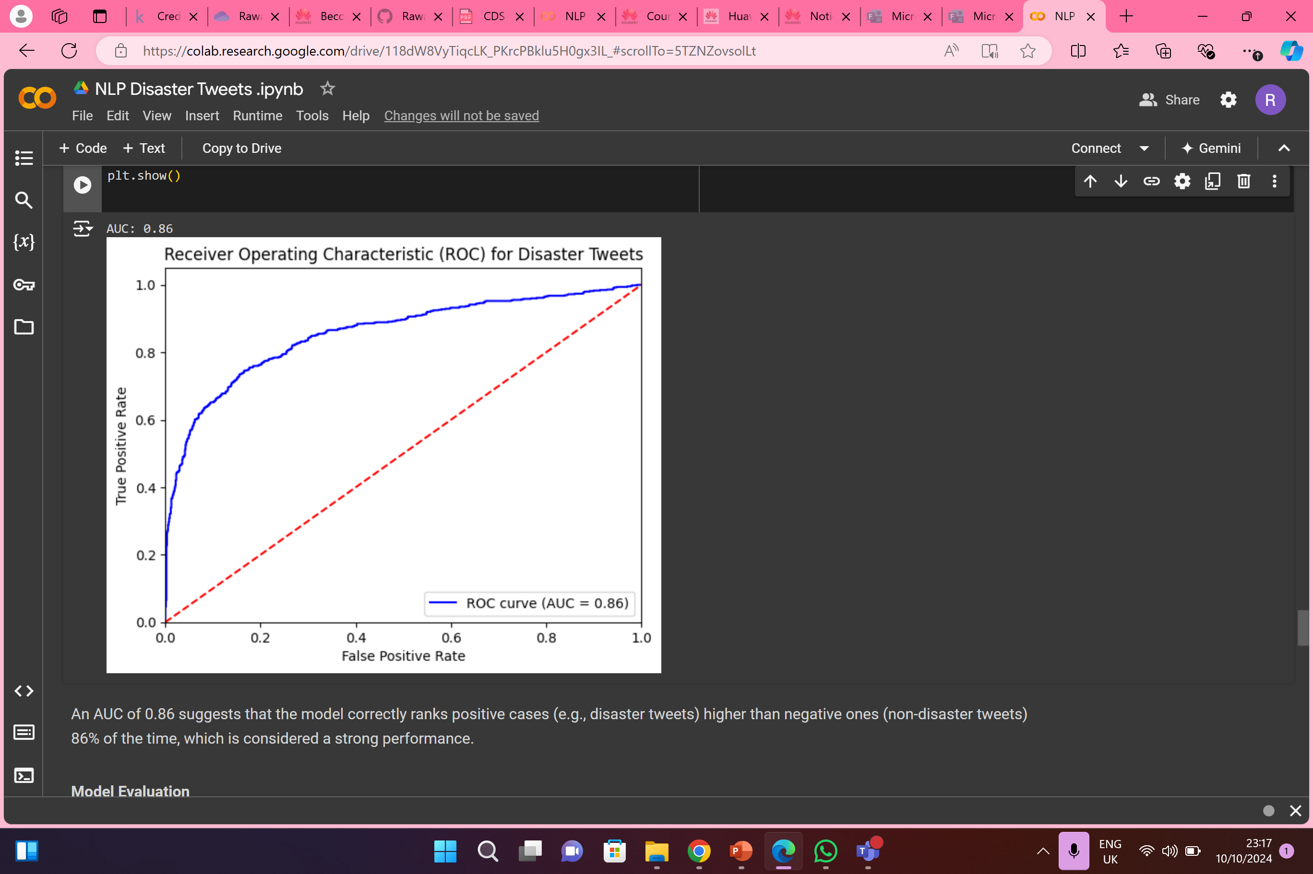
AUC

Slide 17
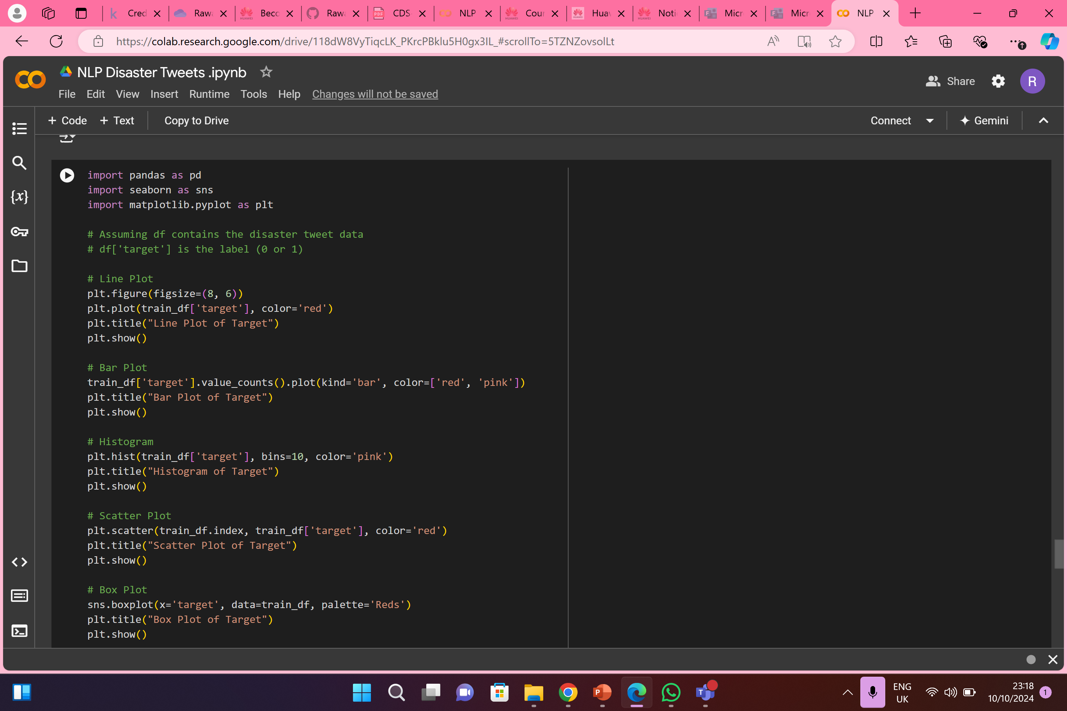
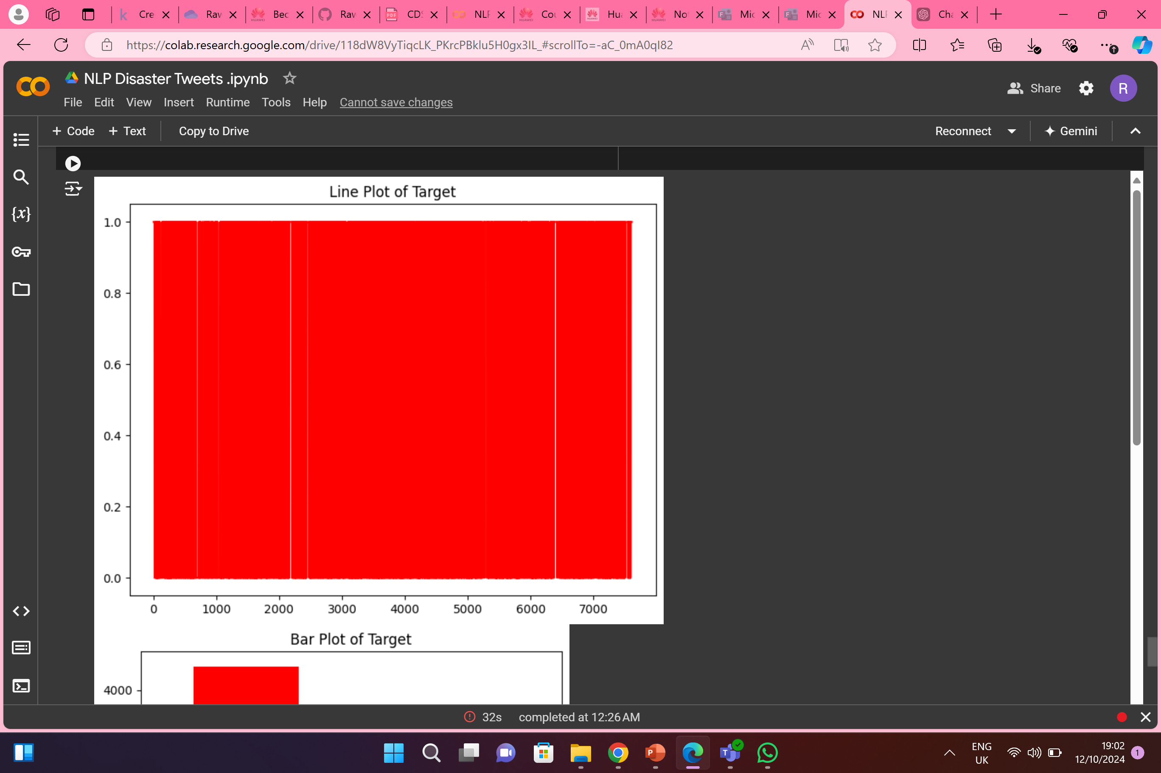
1. Line plot

Slide 18
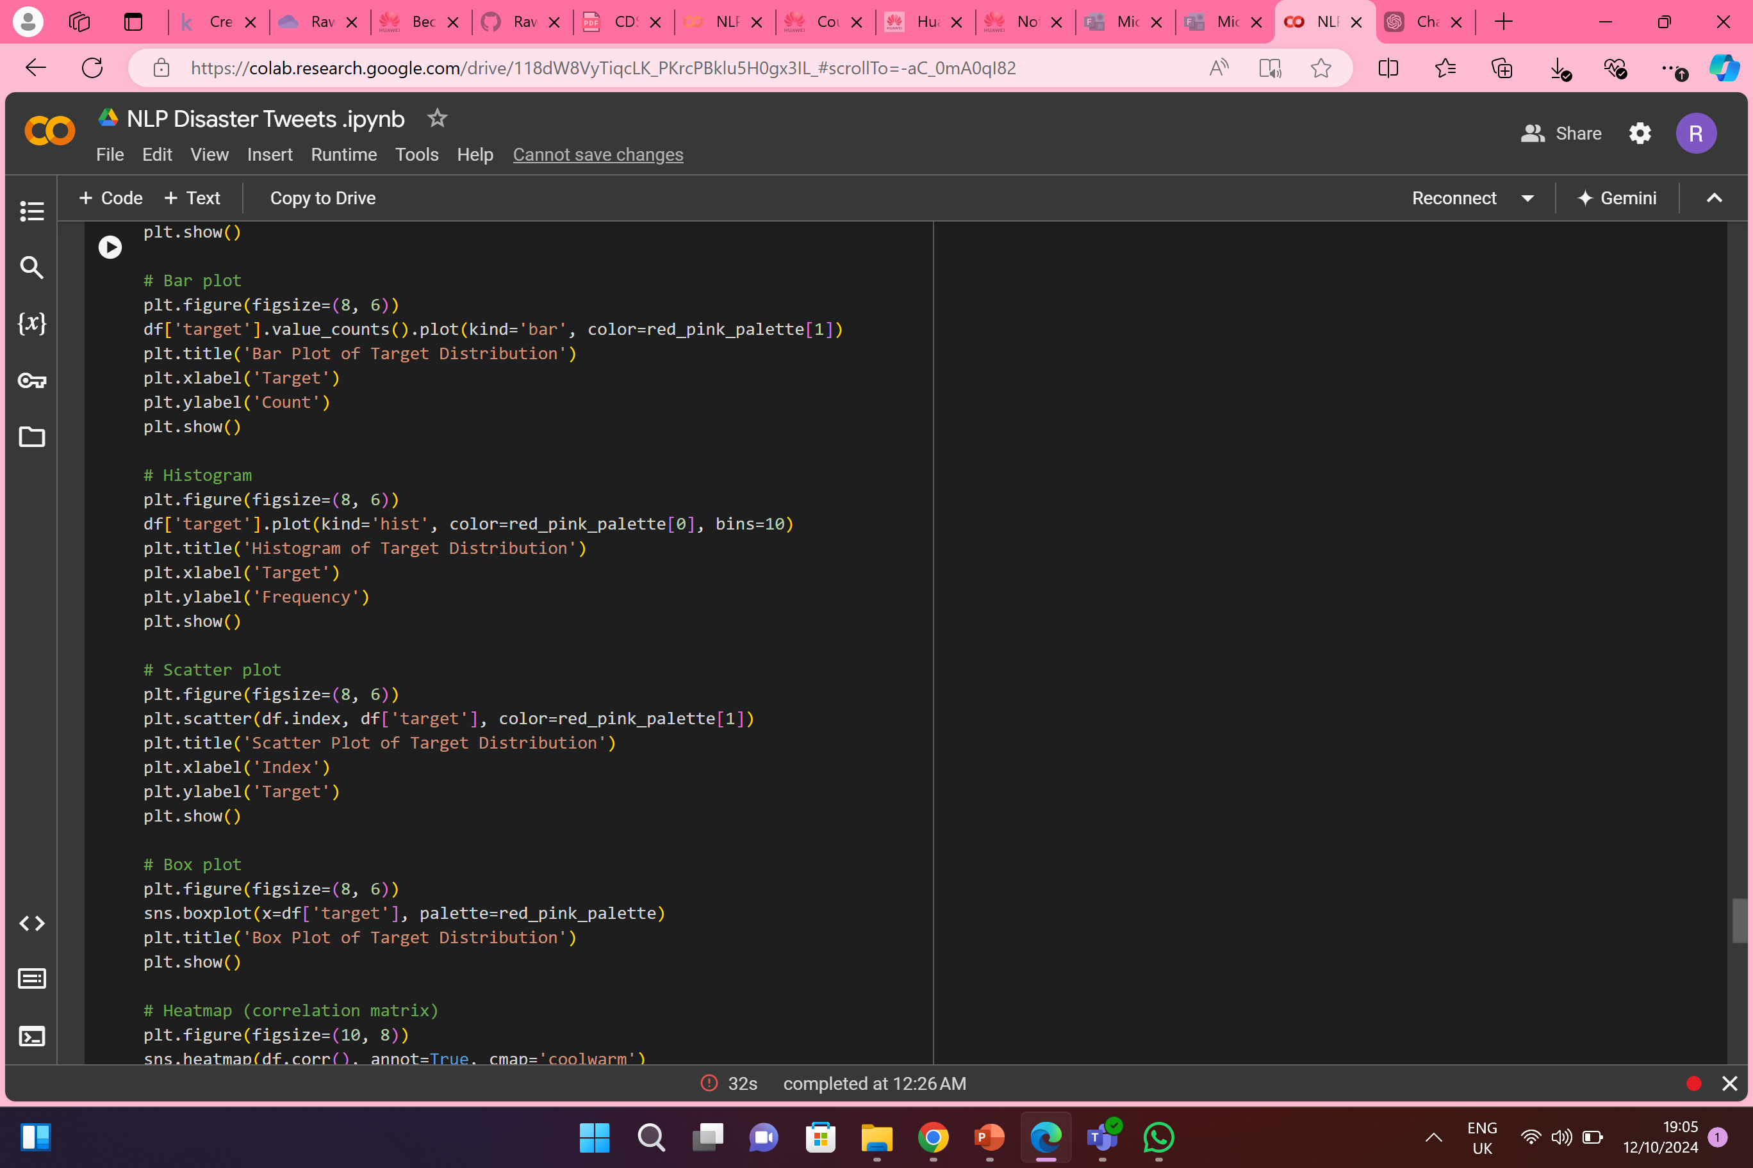
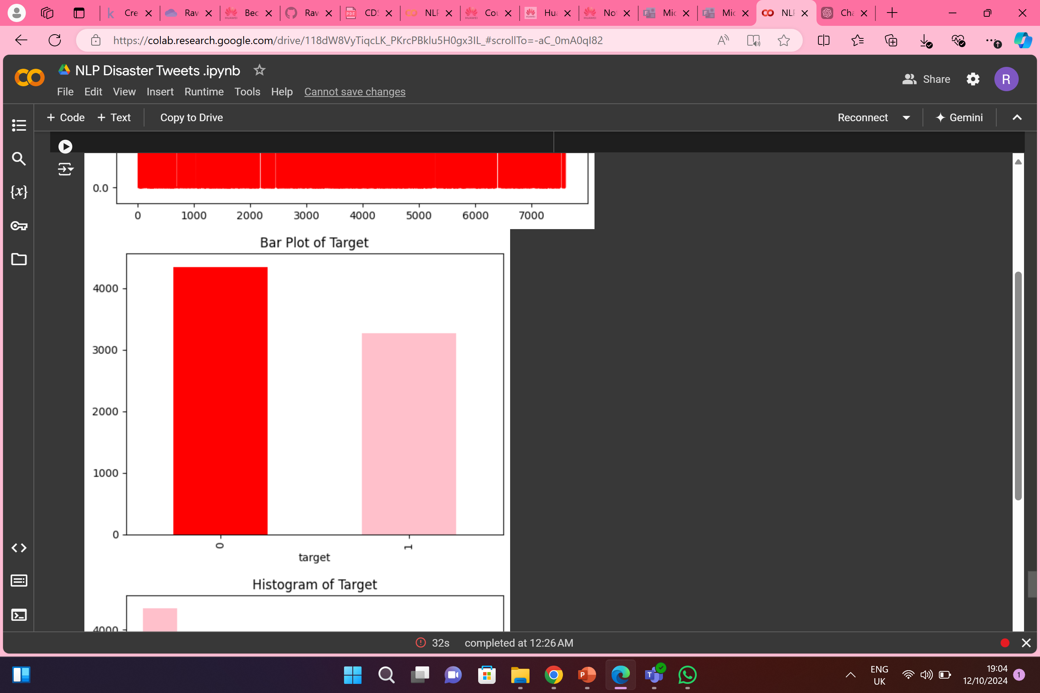
2.Bar plot

Slide 19
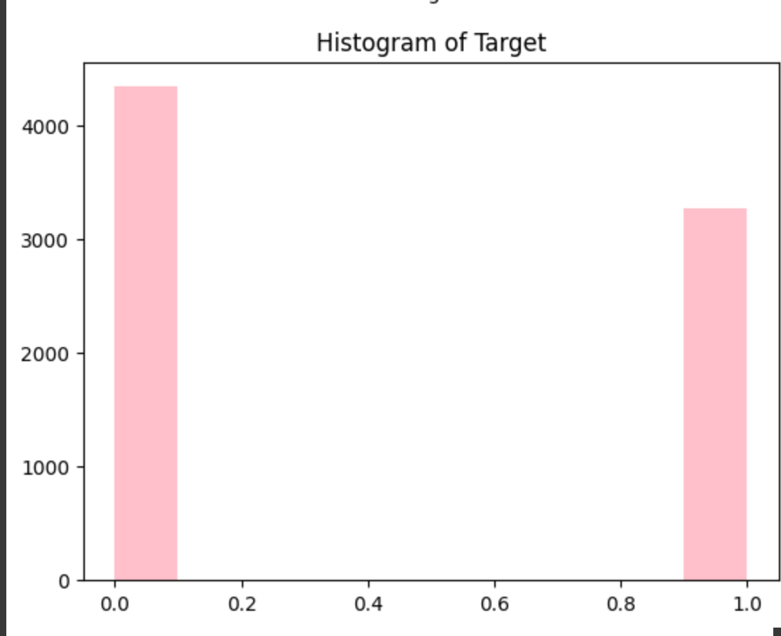
3.Histogram

Slide 20
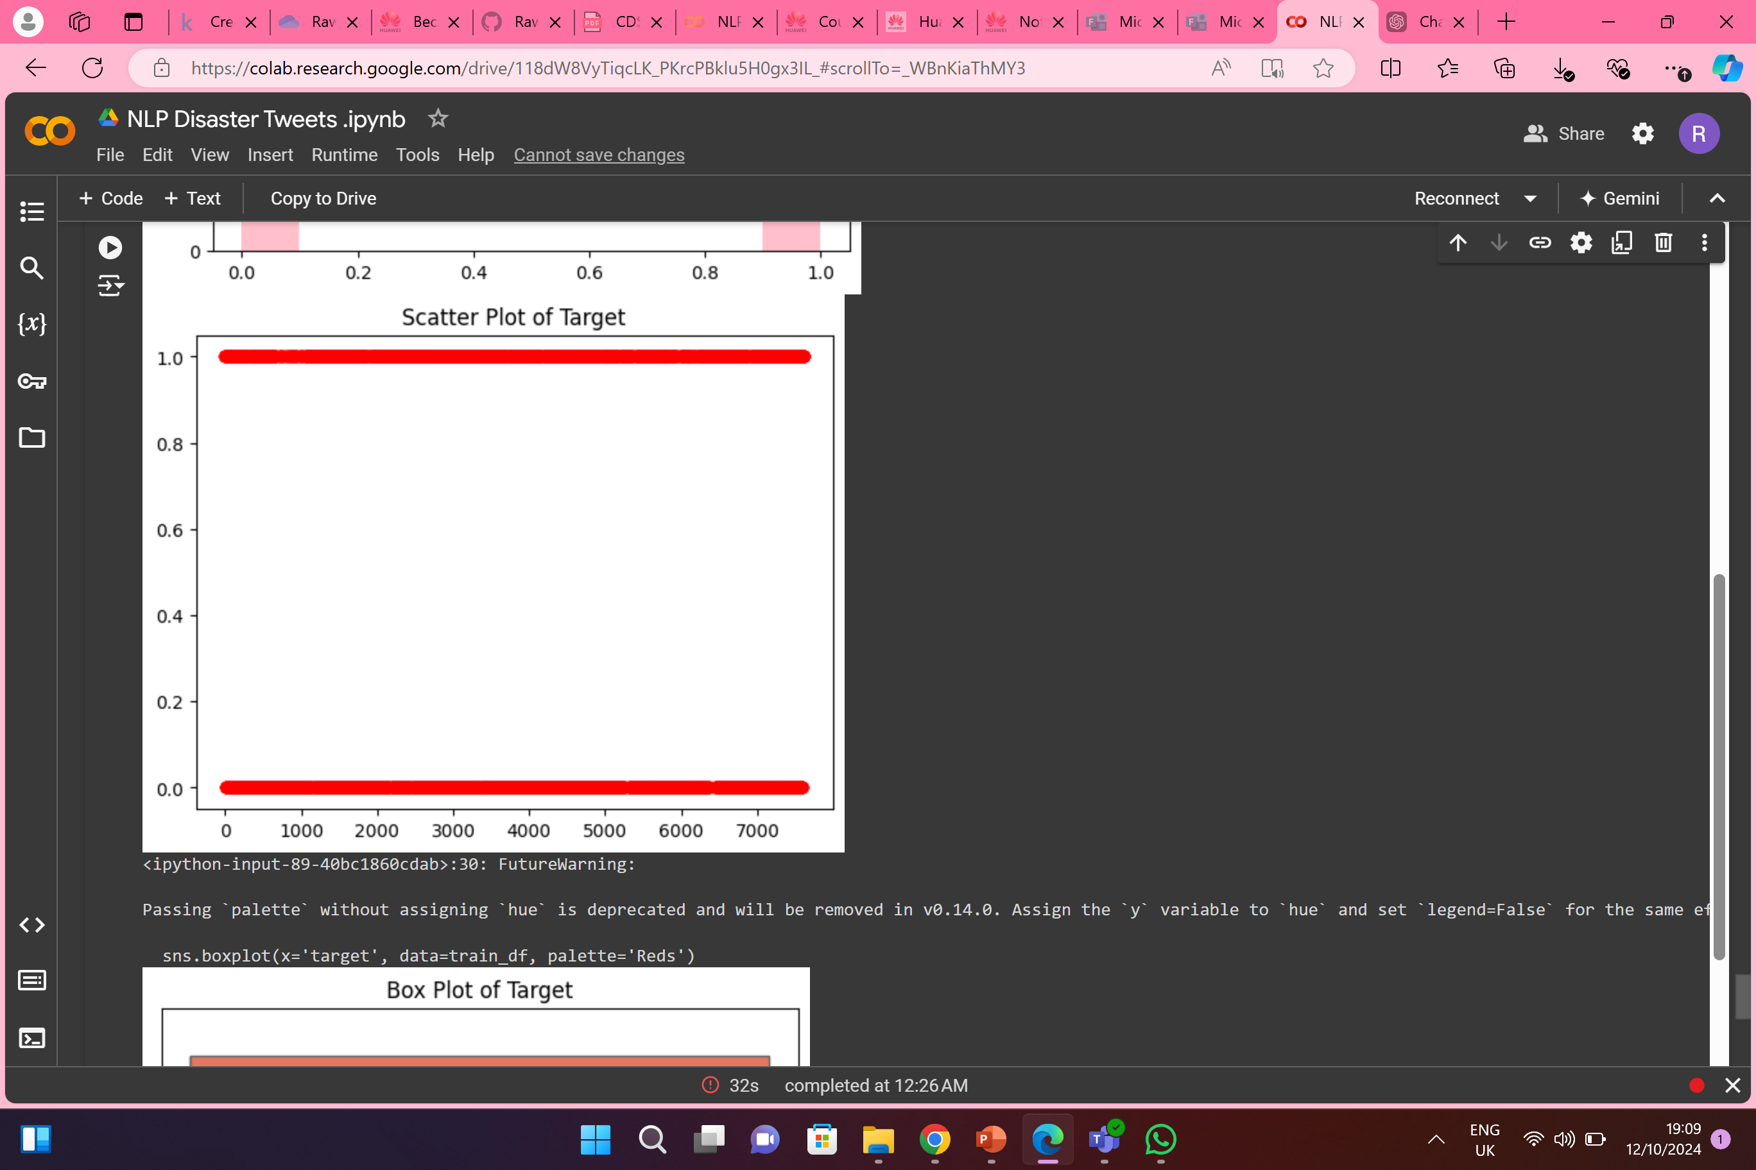
4.Scatter Plot

Slide 21
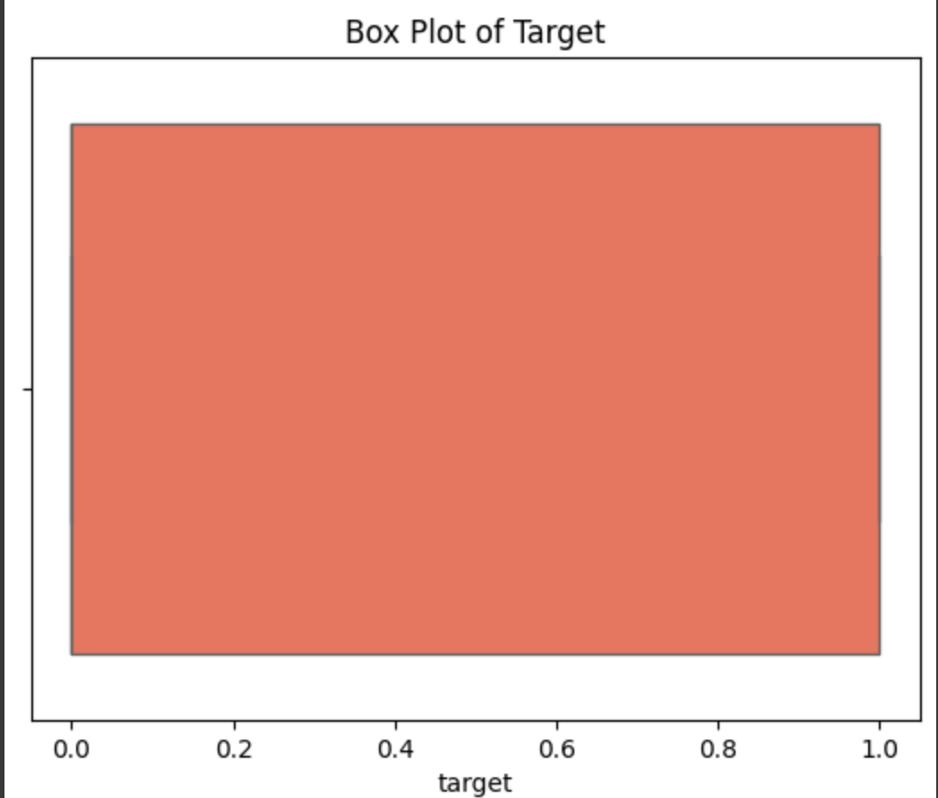
5.Box Plot

Slide 22
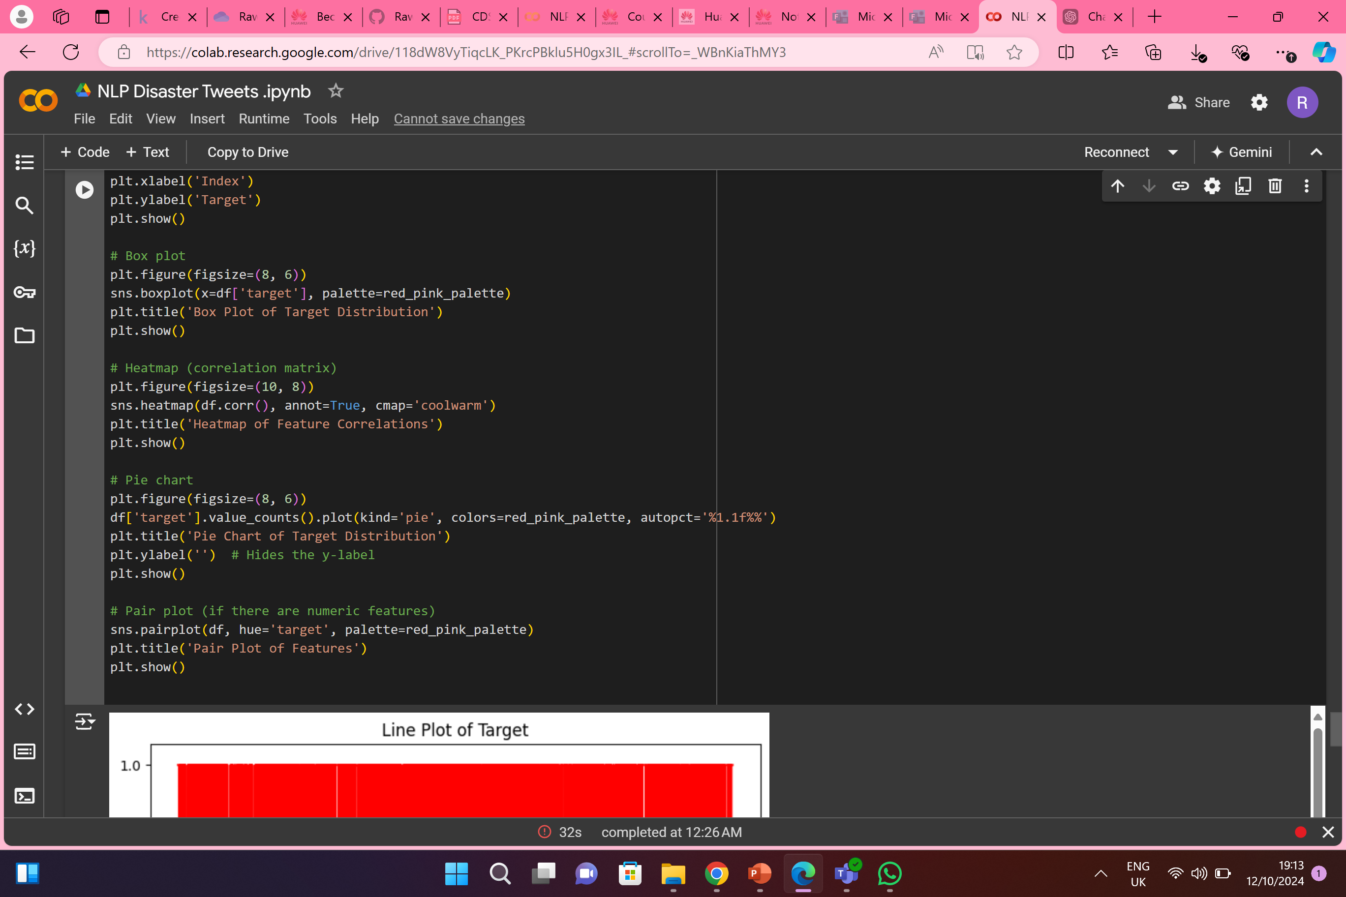
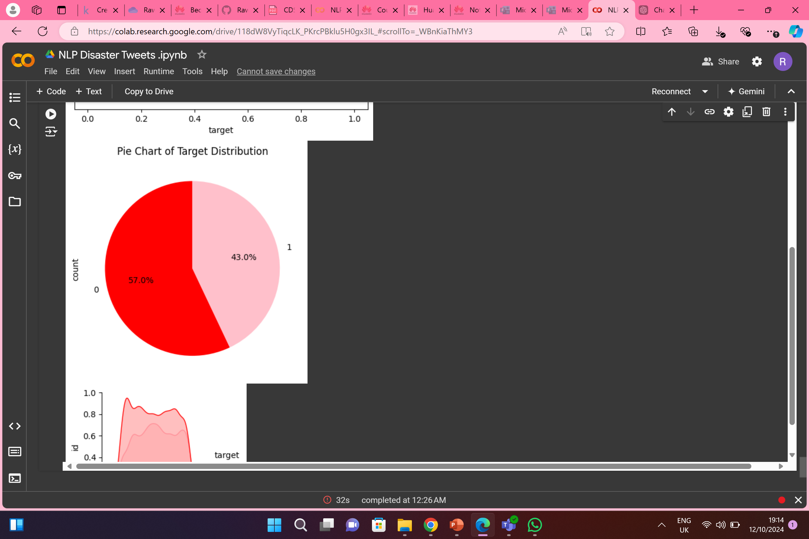
6.Pie chart

Slide 23
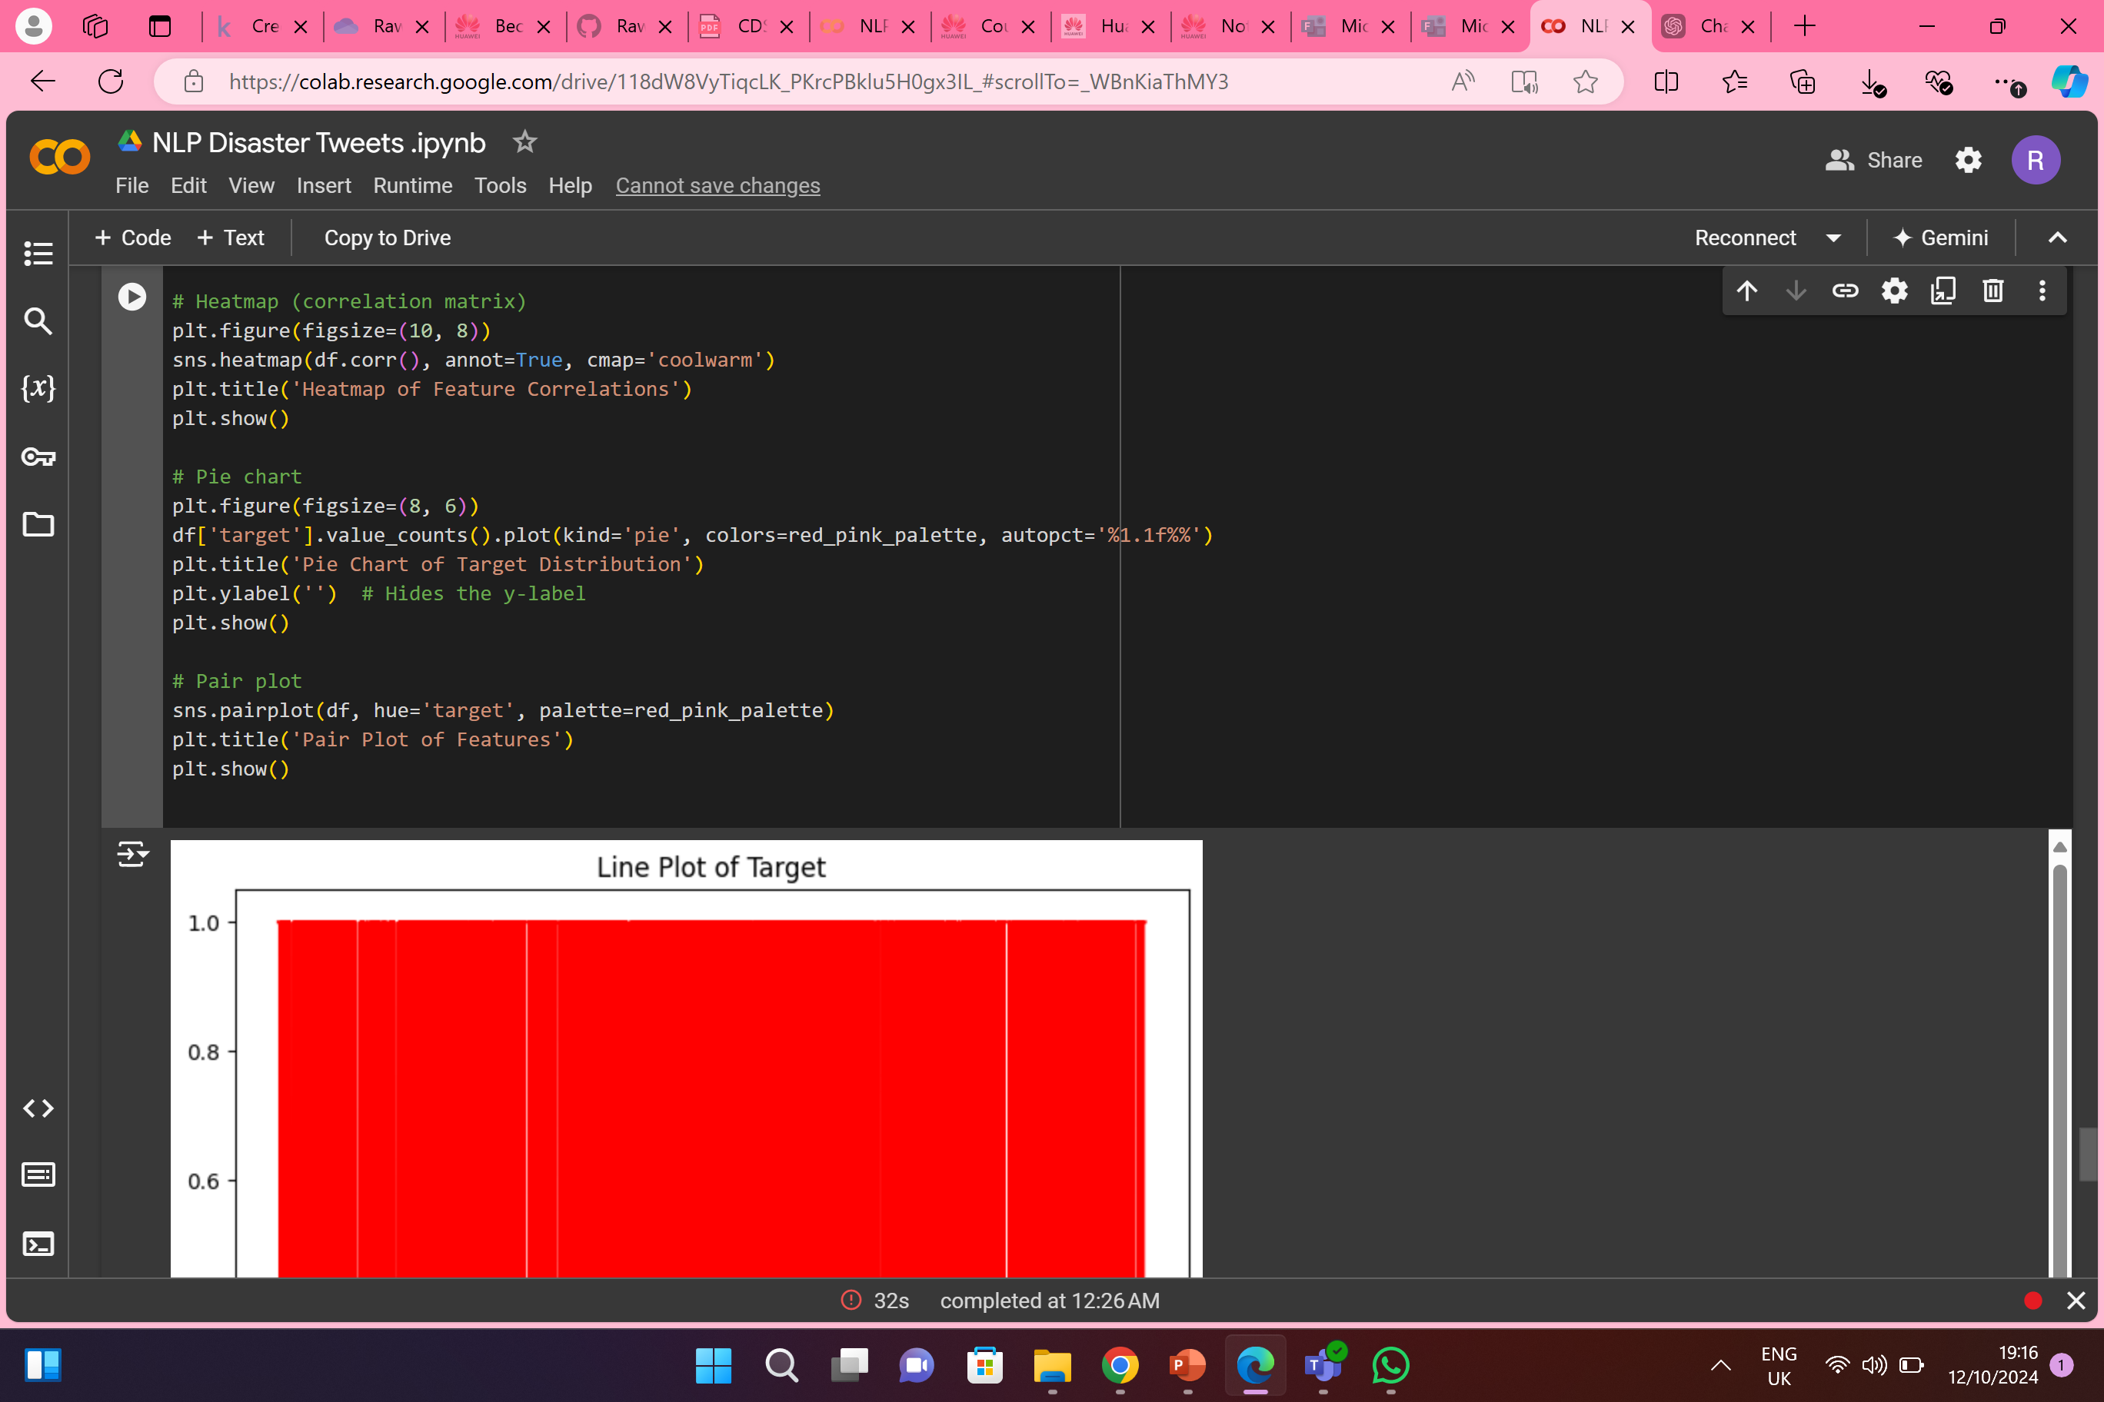
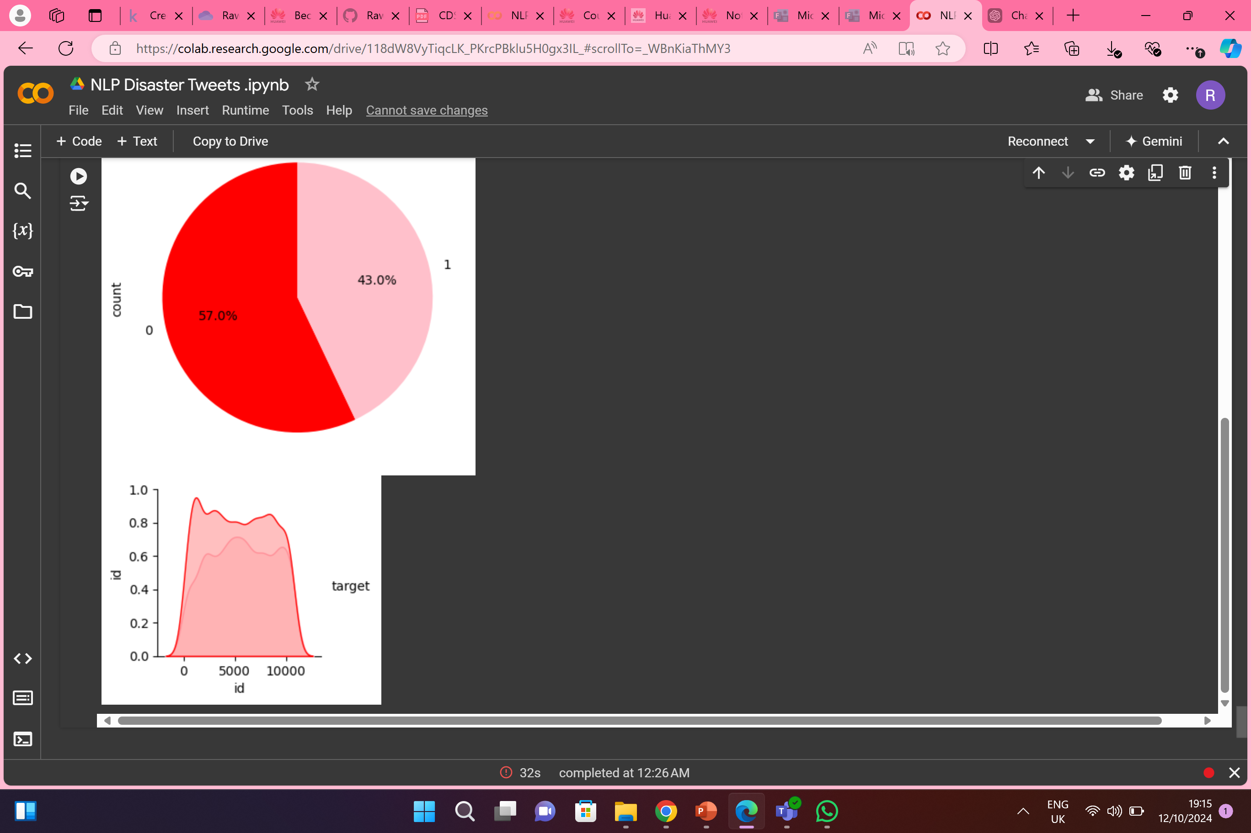
7.Pair Plot

Slide 24
THANKS represented to you by Rawan Mohamed Noorhan Ali Eithar ElShazly Nada Alaa

